Slide 1
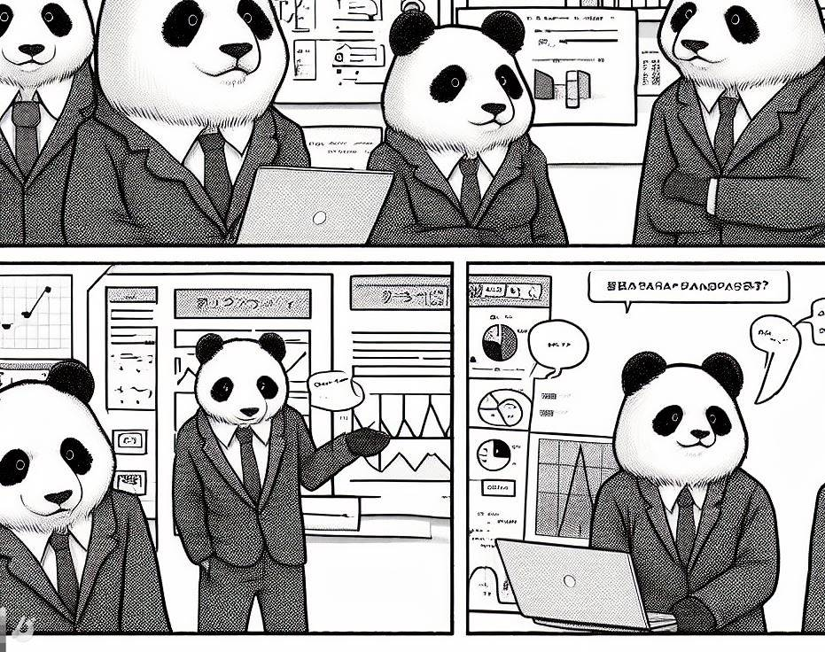
Hands-On Data Analysis with Pandas

Slide 2
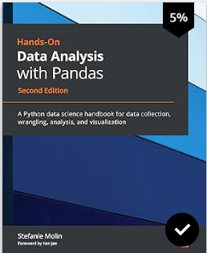
All descriptive statistics in the following slides are described and used in the book “Hands-On Data Analysis with Pandas: A Python data science handbook for data collection,
Wrangling, analysis, and visualization, 2nd Edition.”

Slide 3
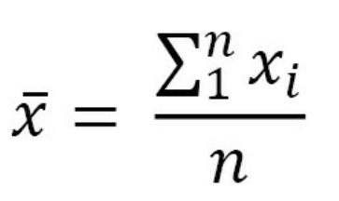
Sample Mean / X-bar
Perhaps the most common statistic for summarizing data is the average or mean. The population mean is denoted by μ (the Greek letter mu), and the sample mean is written as (pronounced X-bar). The sample mean is calculated by summing all the values and dividing by the count of values; for example, the mean of the numbers 0, 1, 1, 2, and 9 is 2.6 ((0 + 1 + 1 + 2 + 9)/5):
We use x_{i} to represent the i^{th} observation of the variable X. Note how the variable as a whole is represented with a capital letter, while the specific observation is lowercase. Σ (the Greek capital letter sigma) is used to represent a summation, which, in the equation for the mean, goes from 1 to n, which is the number of observations.

Slide 4
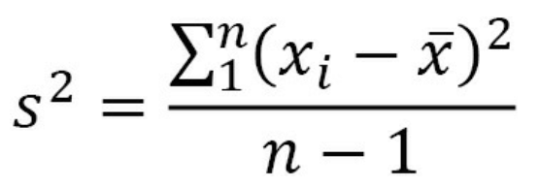
Variance
The variance describes how far apart observations are spread out from their average value (the mean). The population variance is denoted as σ2 (pronounced sigma-squared), and the sample variance is written as s2. It is calculated as the average squared distance from the mean. Note that the distances must be squared so that distances below the mean don't cancel out those above the mean.
If we want the sample variance to be an unbiased estimator of the population variance, we divide by n - 1 instead of n to account for using the sample mean instead of the population mean; this is called Bessel's correction (https://en.wikipedia.org/wiki/Bessel%27s_correction). Most statistical tools will give us the sample variance by default, since it is very rare that we would have data for the entire population:
The variance gives us a statistic with squared units. This means that if we started with data on income in dollars ($), then our variance would be in dollars squared ($2). This isn't really useful when we're trying to see how this describes the data; we can use the magnitude (size) itself to see how spread out something is (large values = large spread), but beyond that, we need a measure of spread with units that are the same as our data. For this purpose, we use the standard deviation.

Slide 5
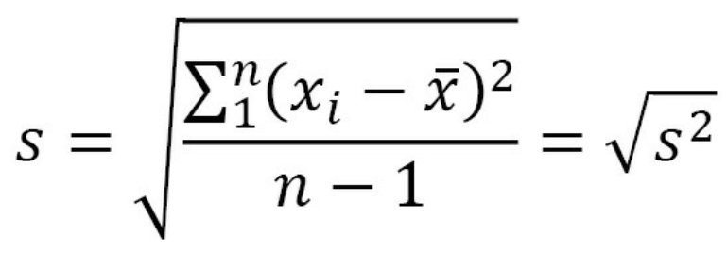
Standard Deviation
The standard deviation is simply the square root of the variance. By performing this operation, we get a statistic in units that we can make sense of again ($ for our income example):
Note that the population standard deviation is represented as σ, and the sample standard deviation is denoted as s.

Slide 6
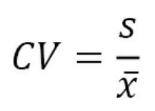
Coefficient of Variance (CV)
When we moved from variance to standard deviation, we were looking to get to units that made sense; however, if we then want to compare the level of dispersion of one dataset to another, we would need to have the same units once again. One way around this is to calculate the coefficient of variation (CV), which is unitless. The CV is the ratio of the standard deviation to the mean:
We will use this metric in Chapter 7, Financial Analysis – Bitcoin and the Stock Market; since the CV is unitless, we can use it to compare the volatility of different assets.

Slide 7
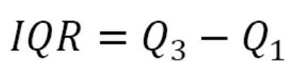
Interquartile Range (IQR)
So far, other than the range, we have discussed mean-based measures of dispersion; now, we will look at how we can describe the spread with the median as our measure of central tendency. As mentioned earlier, the median is the 50th percentile or the 2nd quartile (Q2). Percentiles and quartiles are both quantiles—values that divide data into equal groups each containing the same percentage of the total data. Percentiles divide the data into 100 parts, while quartiles do so into four (25%, 50%, 75%, and 100%). Since quantiles neatly divide up our data, and we know how much of the data goes in each section, they are a perfect candidate for helping us quantify the spread of our data. One common measure for this is the interquartile range (IQR), which is the distance between the 3rd and 1st quartiles:
The IQR gives us the spread of data around the median and quantifies how much dispersion we have in the middle 50% of our distribution. It can also be useful when checking the data for outliers, which we will cover in Chapter 8, Rule-Based Anomaly Detection. In addition, the IQR can be used to calculate a unitless measure of dispersion, which we will discuss next.

Slide 8
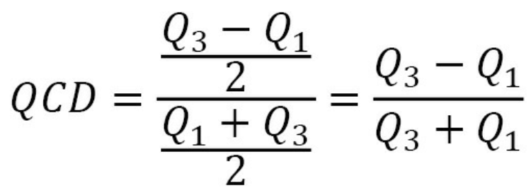
Quartile Coefficient of Dispersion(QCD)
Just like we had the coefficient of variation when using the mean as our measure of central tendency, we have the quartile coefficient of dispersion when using the median as our measure of center. This statistic is also unitless, so it can be used to compare datasets. It is calculated by dividing the semi-quartile range (half the IQR) by the midhinge (midpoint between the first and third quartiles):

Slide 9


Summarizing Data

Slide 10
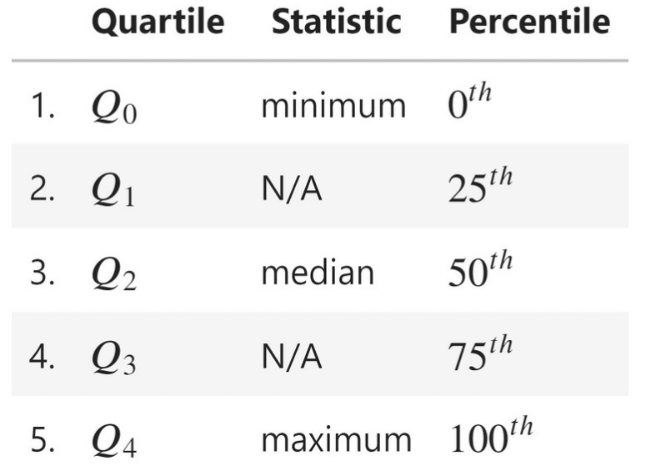
5-number Summary
We have seen many examples of descriptive statistics that we can use to summarize our data by its center and dispersion; in practice, looking at the 5-number summary and visualizing the distribution prove to be helpful first steps before diving into some of the other aforementioned metrics. The 5-number summary, as its name indicates, provides five descriptive statistics that summarize our data:

Slide 11
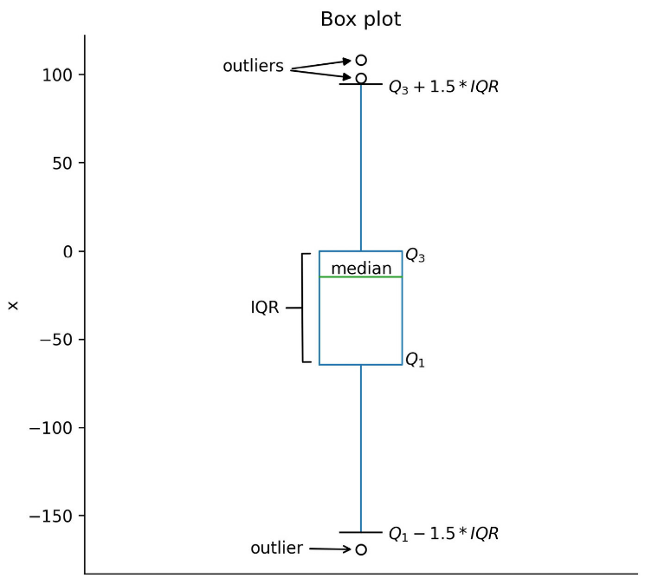
Box Plot
A box plot (or box and whisker plot) is a visual representation of the 5-number summary. The median is denoted by a thick line in the box. The top of the box is Q3 and the bottom of the box is Q1. Lines (whiskers) extend from both sides of the box boundaries toward the minimum and maximum. Based on the convention our plotting tool uses, though, they may only extend to a certain statistic; any values beyond these statistics are marked as outliers (using points). For this book in general, the lower bound of the whiskers will be Q1 – 1.5 * IQR and the upper bound will be Q3 + 1.5 * IQR, which is called the Tukey box plot:

Slide 12
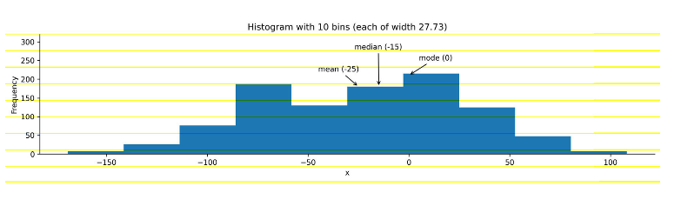
Histogram
While the box plot is a great tool for getting an initial understanding of the distribution, we don't get to see how things are distributed inside each of the quartiles. For this purpose, we turn to histograms for discrete variables (for instance, the number of people or books) and kernel density estimates (KDEs) for continuous variables (for instance, heights or time). There is nothing stopping us from using KDEs on discrete variables, but it is easy to confuse people that way. Histograms work for both discrete and continuous variables; however, in both cases, we must keep in mind that the number of bins we choose to divide the data into can easily change the shape of the distribution we see.
To make a histogram, a certain number of equal-width bins are created, and then bars with heights for the number of values we have in each bin are added. The following plot is a histogram with 10 bins, showing the three measures of central tendency for the same data that was used to generate the box plot.

Slide 13
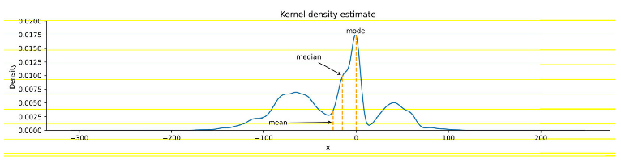
Histogram
While the box plot is a great tool for getting an initial understanding of the distribution, we don't get to see how things are distributed inside each of the quartiles. For this purpose, we turn to histograms for discrete variables (for instance, the number of people or books) and kernel density estimates (KDEs) for continuous variables (for instance, heights or time). There is nothing stopping us from using KDEs on discrete variables, but it is easy to confuse people that way. Histograms work for both discrete and continuous variables; however, in both cases, we must keep in mind that the number of bins we choose to divide the data into can easily change the shape of the distribution we see. KDEs are like histograms, except rather than creating bins for the data, they draw a smoothed curve, which is an estimate of the distribution's probability density function (PDF). The PDF is for continuous variables and tells us how probability is distributed over the values. Higher values for the PDF indicate higher likelihoods:

Slide 14
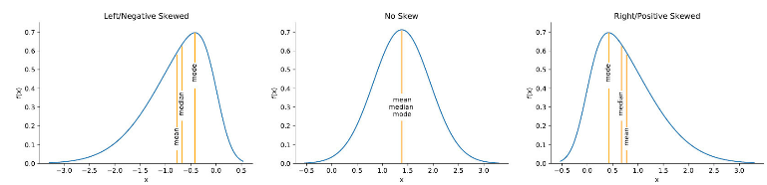
Histogram: Skewed Distribution
When the distribution starts to get a little lopsided with long tails on one side, the mean measure of center can easily get pulled to that side. Distributions that aren't symmetric have some skew to them. A left (negative) skewed distribution has a long tail on the left-hand side; a right (positive) skewed distribution has a long tail on the right-hand side. In the presence of negative skew, the mean will be less than the median, while the reverse happens with a positive skew. When there is no skew, both will be equal:
Important note
There is also another statistic called kurtosis, which compares the density of the center of the distribution with the density at the tails. Both skewness and kurtosis can be calculated with the SciPy package.

Slide 15
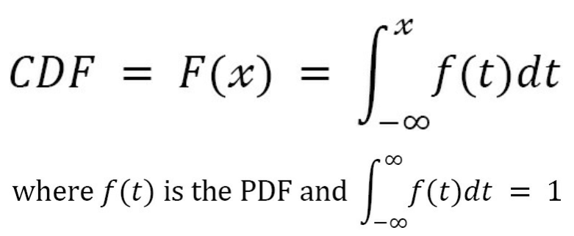
Histogram: Cumulative Distribution Function (CDF)
Each column in our data is a random variable, because every time we observe it, we get a value according to the underlying distribution—it's not static. When we are interested in the probability of getting a value of x or less, we use the cumulative distribution function (CDF), which is the integral (area under the curve) of the PDF:

Slide 16
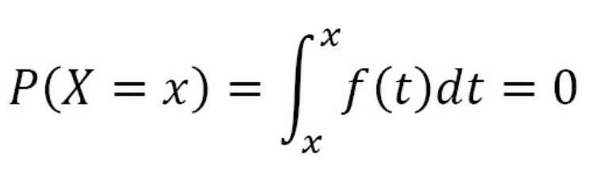
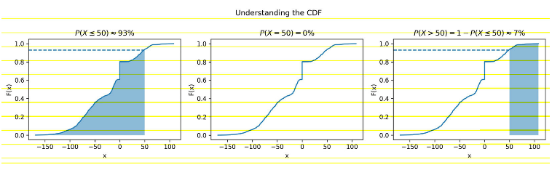
Histogram: Cumulative Distribution Function (CDF)
The probability of the random variable X being less than or equal to the specific value of x is denoted as P(X ≤ x). With a continuous variable, the probability of getting exactly x is 0. This is because the probability will be the integral of the PDF from x to x (area under a curve with zero width), which is 0:
In order to visualize this, we can find an estimate of the CDF from the sample, called the empirical cumulative distribution function (ECDF). Since this is cumulative, at the point where the value on the x-axis is equal to x, the y value is the cumulative probability of P(X ≤ x). Let's visualize P(X ≤ 50), P(X = 50), and P(X > 50) as an example:

Slide 17
Common Distributions
While there are many probability distributions, each with specific use cases, there are some that we will come across often. The Gaussian, or normal, looks like a bell curve and is parameterized by its mean or “mu” (μ) and standard deviation (σ). The standard normal (Z) has a mean of 0 and a standard deviation of 1. Many things in nature happen to follow the normal distribution, such as heights. Note that testing whether a distribution is normal is not trivial—check the Further reading section for more information.
The Poisson distribution is a discrete distribution that is often used to model arrivals. The time between arrivals can be modeled with the exponential distribution. Both are defined by their mean, lambda (λ). The uniform distribution places equal likelihood on each value within its bounds. We often use this for random number generation. When we generate a random number to simulate a single success/failure outcome, it is called a Bernoulli trial. This is parameterized by the probability of success (p). When we run the same experiment multiple times (n), the total number of successes is then a binomial random variable. Both the Bernoulli and binomial distributions are discrete.

Slide 18
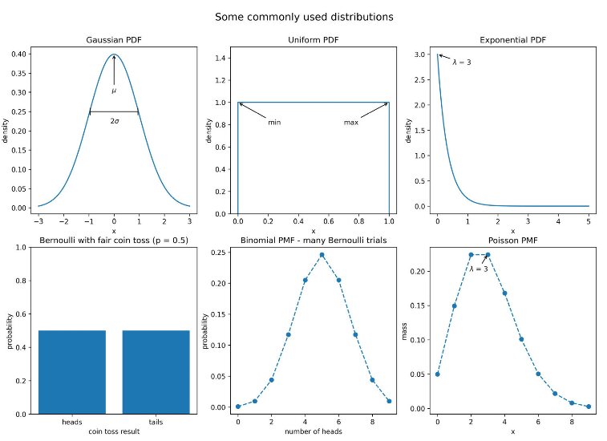
Probability Mass Function (PMF)
We can visualize both discrete and continuous distributions; however, discrete distributions give us a probability mass function (PMF) instead of a PDF. We will use some of these distributions in Chapter 8, Rule-Based Anomaly Detection, when we simulate some login attempt data for anomaly detection.

Slide 19
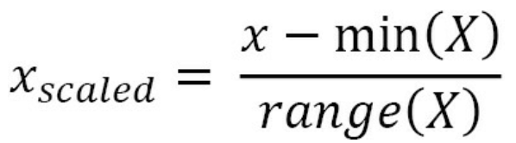
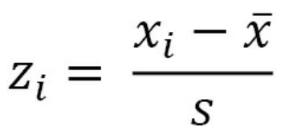
Scaling Data
In order to compare variables from different distributions, we would have to scale the data, which we could do with the range by using min-max scaling. We take each data point, subtract the minimum of the dataset, then divide by the range. This normalizes our data (scales it to the range [0, 1]):
This isn't the only way to scale data; we can also use the mean and standard deviation. In this case, we would subtract the mean from each observation and then divide by the standard deviation to standardize the data. This gives us what is known as a Z-score:
We are left with a normalized distribution with a mean of 0 and a standard deviation (and variance) of 1. The Z-score tells us how many standard deviations from the mean each observation is; the mean has a Z-score of 0, while an observation of 0.5 standard deviations below the mean will have a Z-score of -0.5. There are, of course, additional ways to scale our data, and the one we end up choosing will be dependent on our data and what we are trying to do with it. By keeping the measures of central tendency and measures of dispersion in mind, you will be able to identify how the scaling of data is being done in any other methods you come across.

Slide 20

Quantifying Relationships Between Variables
In the previous sections, we were dealing with univariate statistics and were only able to say something about the variable we were looking at. With multivariate statistics, we seek to quantify relationships between variables and attempt to make predictions for future behavior. The covariance is a statistic for quantifying the relationship between variables by showing how one variable changes with respect to another (also referred to as their joint variance):
Important note
E[X] is a new notation for us. It is read as the expected value of X or the expectation of X, and it is calculated by summing all the possible values of X multiplied by their probability—it's the long-run average of X.

Slide 21
Quantifying Relationships Between Variables
In the previous sections, we were dealing with univariate statistics and were only able to say something about the variable we were looking at. With multivariate statistics, we seek to quantify relationships between variables and attempt to make predictions for future behavior. The covariance is a statistic for quantifying the relationship between variables by showing how one variable changes with respect to another (also referred to as their joint variance):
Important note
E[X] is a new notation for us. It is read as the expected value of X or the expectation of X, and it is calculated by summing all the possible values of X multiplied by their probability—it's the long-run average of X.

Slide 22
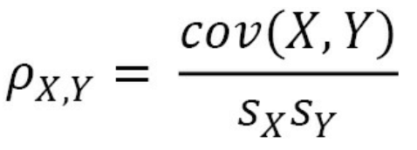
Pearson Correlation Coefficient
The magnitude of the covariance isn't easy to interpret, but its sign tells us whether the variables are positively or negatively correlated. However, we would also like to quantify how strong the relationship is between the variables, which brings us to correlation. Correlation tells us how variables change together both in direction (same or opposite) and magnitude (strength of the relationship). To find the correlation, we calculate the Pearson correlation coefficient, symbolized by ρ (the Greek letter rho), by dividing the covariance by the product of the standard deviations of the variables:
This normalizes the covariance and results in a statistic bounded between -1 and 1, making it easy to describe both the direction of the correlation (sign) and the strength of it (magnitude). Correlations of 1 are said to be perfect positive (linear) correlations, while those of -1 are perfect negative correlations. Values near 0 aren't correlated. If correlation coefficients are near 1 in absolute value, then the variables are said to be strongly correlated; those closer to 0.5 are said to be weakly correlated.
LEFT OFF ON PAGE 70 OF THE BOOK

